Slide 1

Encoder-Decoder Architecture for Sequence-to-Sequence Tasks
Week 8 Mini Survey Luis Alberto Portilla López

Slide 2
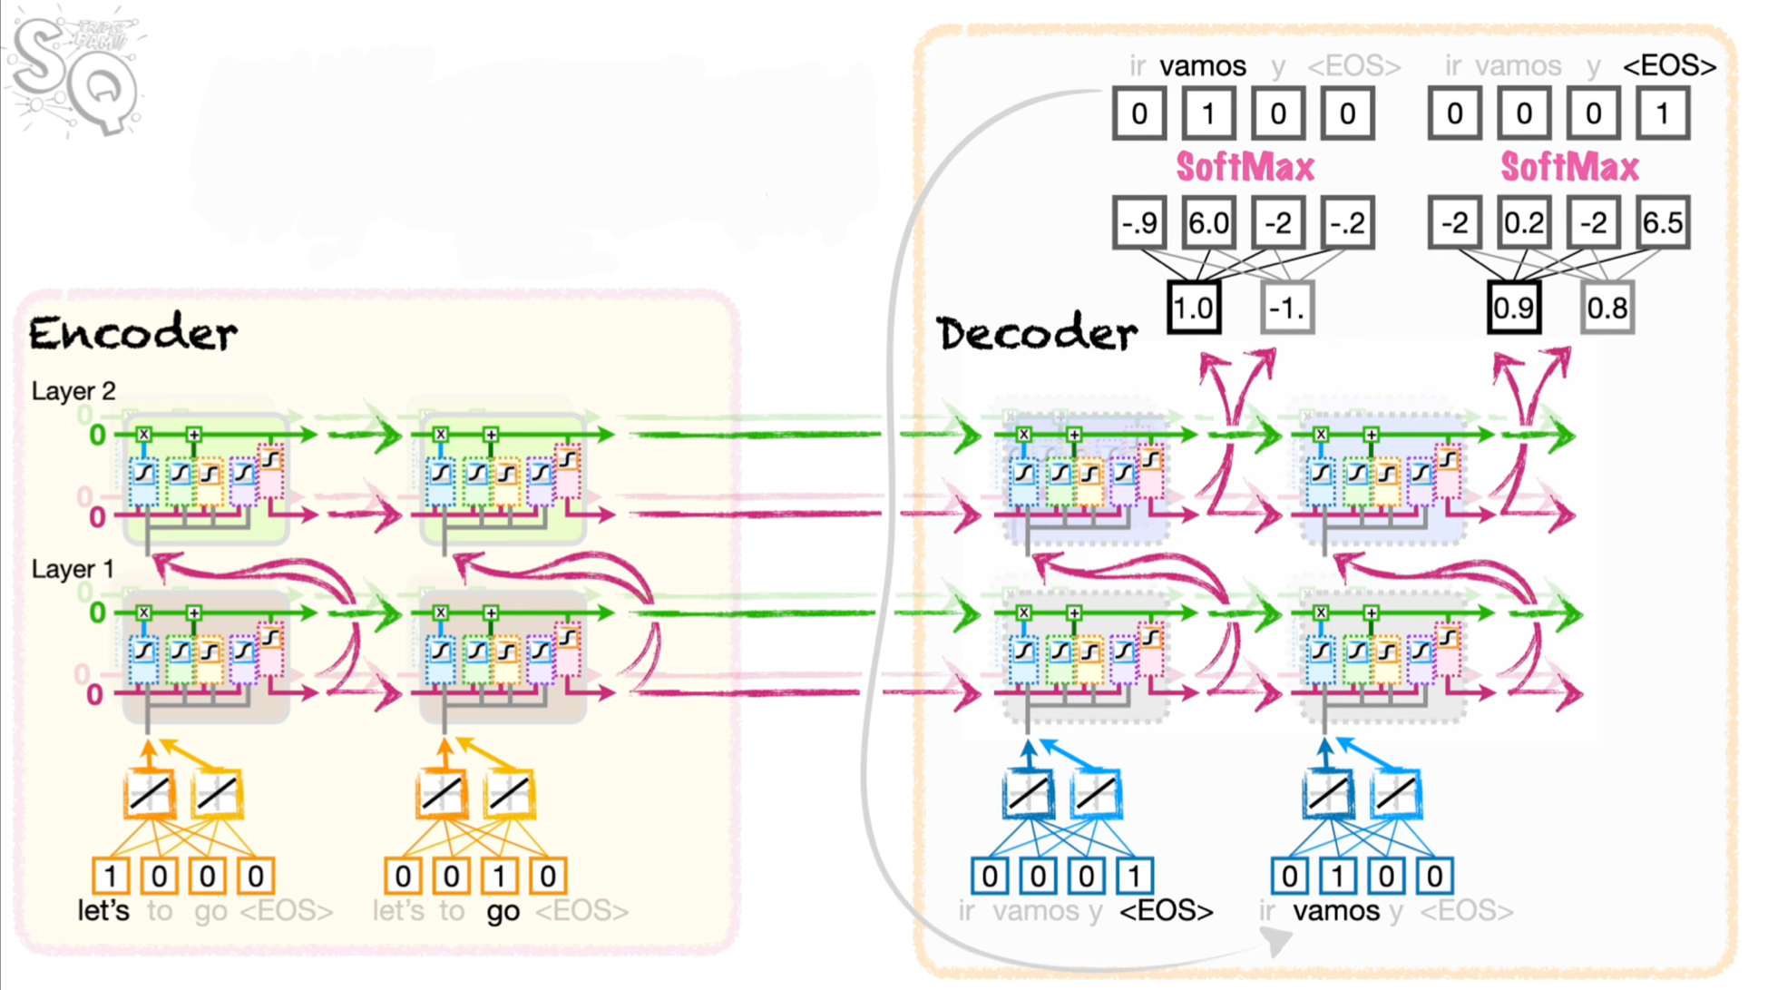
Encoder-Decoder Architecture
Architecture and very simple information flow visualization

Slide 3
Challenges & Limitations
Context vector can be limited in information due to the fixed size
When using LSTM, the information passing from one layer to another helps with higher level understanding, but also struggles to maintain relevance and scope with longer sequences

Slide 4

Search Methodology & Criteria
Keyword Search
Boolean Search
Citation Chaining and Forward Citation
CRITERIA:
• Initial review of abstracts to assess relevance based on the title, publication venue, and year.
• Direct and indirect relevance to the paper being cross-referenced through the abstract.
• Consideration of the number of citations and field-weighted citation impact (fwci), a metric that measures the citation impact of a paper adjusted for disciplinary differences.

Slide 5

Preliminary Terms
Key terms identified during the week:
Sequence-to-sequence
• Context Vector
Attention
Layers

Slide 6


Document Comparison
“Evaluating Sequence-to-Sequence Models for Handwritten Text Recognition”
“Sentence-Level Grammatical Error Identification as Sequence-to-Sequence Correction”
“Understanding How Encoder-Decoder Architectures Attend”
“Sequence to Sequence Learning with Neural Networks”

Slide 7
Criteria | Evaluating Sequence-to-Sequence Models for Handwritten Text Recognition | Sequence to Sequence Learning with Neural Networks | Sentence-Level Grammatical Error Identification as Sequence-to-Sequence Correction | Understanding How Encoder-Decoder Architectures Attend
Primary Focus | Handwritten text recognition using encoder-decoder models. | Machine translation with encoder-decoder models. | Grammatical error correction using sequence-to-sequence models. | Examines how word embeddings perform in sentiment analysis tasks
Architecture Details | CNN-based feature extractor with RNN encoder-decoder architecture. | Stacked LSTMs in both encoder and decoder without attention. | Encoder-decoder with sequence tagging for identifying and correcting grammatical errors. | Enhanced encoder-decoder with integrated attention layers.
Dataset Used | Custom handwritten text datasets for training and validation. | WMT’14 English-to-French translation dataset. | CoNLL-2014 shared task dataset for grammatical error correction. | Synthetic datasets and benchmark datasets like IWSLT for translation tasks.
Evaluation Metrics | Accuracy, character error rate (CER), word error rate (WER). | BLEU score for translation quality assessment. | Precision, recall, F1 score for error correction quality. | Attention alignment accuracy, BLEU score, translation quality metrics.

Slide 8
Criteria | Evaluating Sequence-to-Sequence Models for Handwritten Text Recognition | Sequence to Sequence Learning with Neural Networks | Sentence-Level Grammatical Error Identification as Sequence-to-Sequence Correction | Understanding How Encoder-Decoder Architectures Attend
Optimization Techniques | End-to-end training with a hybrid loss function. | Deep LSTM layers and regularization techniques for stability. | Tag-based correction for improved grammatical consistency. | Focus on tuning attention weights and alignment strategies.
Performance Insights | Achieved competitive results in handwritten text recognition; stable CER and WER. | Shows that deep LSTMs can achieve high-quality translations without alignment. | Effective in correcting sentence-level grammar errors with high precision. | Demonstrates improved alignment and context preservation with attention.
Challenges and Limitations | Difficulty in handling highly variable handwriting styles; computational complexity. | Struggles with very long sequences due to limited context vector capacity. | Sensitive to noise and complex error patterns; requires extensive labeled data. | Complexity of tuning attention weights; sensitive to overfitting.
Conclusion/ Outcomes | Effective for handwritten text recognition but requires further tuning for complex handwriting. | Pioneered sequence-to-sequence learning and influenced subsequent models with attention. | Demonstrates encoder-decoder utility in grammar correction; emphasizes need for better noise handling. | Shows how attention enhances encoder-decoder models, leading to better handling of long sequences.

Slide 9
References
Michael, J., Labahn, R., Grüning, T., & Zöllner, J. (2019). Evaluating Sequence-to-Sequence Models for Handwritten Text Recognition. Proceedings of the IEEE/CVF Conference on Computer Vision and Pattern Recognition (CVPR) Workshops, 2019, 3281–3287.
Sutskever, I., Vinyals, O., & Le, Q. V. (2014). Sequence to Sequence Learning with Neural Networks. Advances in Neural Information Processing Systems, 27, 3104–3112.
Yuan, Z., Briscoe, T., & Felice, M. (2016). Sentence-Level Grammatical Error Identification as Sequence-to-Sequence Correction. Proceedings of the 11th Workshop on Innovative Use of NLP for Building Educational Applications, 287–292.
Chefer, H., Gur, S., & Wolf, L. (2021). Understanding How Encoder-Decoder Architectures Attend

